Slide 1
Integrating Soft Skills Into Stage I Occupation-Specific Language Training
Case Study
Characteristics of Stage I OSLT
Missing Link
Revised Lessons
Ann Chen, ESL Instructor & Curriculum Developer
annc@keys.ca
Presenting at TESL Kingston on October 20th, 2018

Slide 2
KEYS Newcomer Connections in Construction and Manufacturing
MCI-funded, Economic Integration of Vulnerable Newcomers, running from January 2018 to March 2019;
To support total of 20-24 vulnerable clients with commitment to full-time work in construction and manufacturing;
To provide training in sector-specific skills and workplace English and support for job search and retention;
Minimum Canadian Language Benchmark of 2 (=Low Beginner);
Two phases in total and each consists of three stages: Pre-Employment Training (6 weeks), Job Placement (6 weeks), Post-Placement (6 weeks);
In the first 6 weeks, two 3-hour ESL sessions per week plus 1-hour homework;
During job placement period, one 3-hour ESL session per week plus 0.5-hour homework; and
In the last 6 weeks, maximum of one-hour, one-on-one consultation per week if needed.

Slide 3
ESL = 1/5 of the Program !!!

Slide 4
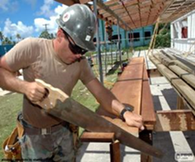
Characteristics of NCCM English Support Sessions
Five modules correspond to hard skills training workshops: Overview of Sector, Measurement, Carpentry, Warehouse Work, Welding;
Each module roughly divided into five parts: Job Profile, Tools & Materials, Personal Protective Equipment, Grammar, Integrated Activities;
Spoken language as primary focus of the language training;
Lots of visual clues and games to encourage participation and interaction; and
Emphasis on terminology and basic grammar.

Slide 5
Primary Resources
Resources | Year of Publication | Trades-Specific | ESL Activities | Soft Skills
Steps to Employment in Ontario: Construction Workshop Manual https://settlement.org/steps/manuals.html | 1999 | Yes | Yes, but for higher levels | Yes, but limited
LLEO Essential Skills Training: Skilled Trades Helper http://www.lleo.ca/resources.html | 2012 | Yes | Yes, but for higher levels | Yes, but limited
LLEO Essential Skills Training: Material Handler http://www.lleo.ca/resources.html | 2012 | Yes | Yes, but for higher levels | Yes, but limited
ESL for Job Success: On-the-Job English | 2000 | Yes, but limited | Yes, level-appropriate | Yes
ESL for Work Activities: A Picture Process Dictionary | 2004 | Yes, but limited | Yes, level-appropriate | Yes
Easy Reading Career Planning Series: Job Profiles https://alis.alberta.ca/inspire-and-motivate/career-advisors-easy-reading-help/ | N/A | Yes, but limited | No | No
Job Bank https://www.jobbank.gc.ca/occupationsearch | N/A | Yes | No | No
Essential Functions for Conversation | 2003 | No | Yes | Yes
ESLlibray.com | N/A | No | Yes, level-appropriate | Yes, but limited

Slide 6
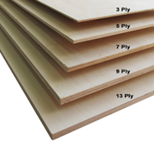
Snapshot of NCCM ESL Session
What does Tom do?
Where does Tom work?
What tools does Tom use for his work?
What materials does Tom work with?
What safety gear should Tom wear for his work?

Slide 7
Revised English Language Instruction
Tom is new to a construction crew. They are taking a coffee break. He chats with his coworkers. Which of the following topics should he avoid? Why?
W
Weather
Age
Hobbies
Religion
Food
Entertainment
Surroundings
Salary
Pragmatics in CLB
INCORPORATE COMMUNICATION SKILLS INTO OSLT
Making Small Talk
Asking for Permission
Asking for Repetition
Asking for Help
Describing Finished Work
Making Apologies
Making Requests
Making Invitations
Expressing Opinions
Introduce a Scenario
Reflect
Focus on Language
Practice

Slide 8
Making Small Talk
Tom is new to a construction crew. They are taking a coffee break. He chats with his coworkers. Which of the following topics should he avoid? Why?
W
Weather
Age
Hobbies
Religion
Food
Entertainment
Surroundings
Salary
Role-play a dialogue and answer the questions.
A: Good morning! Did you get caught by the rain?
B: Yes, I did. The wind was strong.
A: Sure was. And guess what? We’re going to get more rain this
weekend.
B: Oh no.
A: Looks like everyone is here. Let’s get this meeting started.
What is the topic of this small talk?
Do you think these two people know each other?
Where do you think this conversation takes place?
What do you think is the purpose of the small talk?

Slide 9
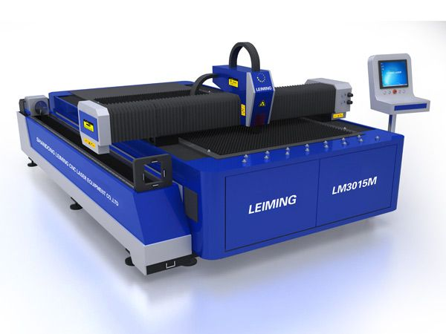
Asking for Repetition
Sonia is getting instructions from his supervisor, Mike.
First, put a sheet of metal along the right edge of the cutting machine. Then, key in the size that you need. After that, pull down the cutting blade. When you’re done, lift the blade and inspect each piece to make sure the edges are smooth. Finally, put the finished pieces in your storage tray. If a piece is defective, write that down in the logbook.
In a group, write …
3 follow-up questions to help students understand
the importance of asking clarification questions;
In a group, discuss …
language expressions to be taught in following
instructions; and
In a group, propose …
a follow-up activity to help consolidate the concept
and language learned.
Introduce a Scenario
Reflect
Focus on Language
Practice

Slide 10
Making Apologies
Jen works for Tip Top Furniture Designs. She works with a table saw. She has to wear special safety gear. Today Mike, her supervisor, is warning her about using the wrong equipment.
In a group, write …
3 follow-up questions to help students understand
the importance of acknowledging one’s own mistakes;
In a group, discuss …
language expressions to be taught in making
apologies; and
In a group, propose …
a follow-up activity to help consolidate the concept
and language learned.
Introduce a Scenario
Reflect
Focus on Language
Practice

Slide 11
Questions, Comments, or Suggestions?
Thank You for Your Attention!!!

